Slide 1

CREDIT RISK ANALYSIS
Regaip KURT

Slide 2
CREDIT RISK ANALYSIS
Basel regulatorıes
RISK ANALYSIS
TOOLS AND IMPLEMENTATION

Slide 3
BASEL REGULATORIES
BIS (Bank for International Settlements)
Basel is a list of comprehensive reforms whose goal is to strengthen the regulation, supervision and risk management of the banking sector.
Basel I – 1989, Basel II – 2004, Basel III – 2010
GOALS
Capital Adequacy
Reserve Transparency
Monetary and Financial Stability

Slide 4
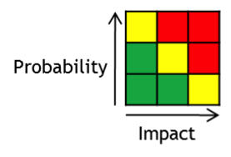
RISK ANALYSIS
What is Probability and Impact ?
Probability – Probability of Default
Impact – Capital Loss
EAD = Exposure at Default
LGD = Loss Given Default
PD = Probability of Default
Expected Loss = PD x EAD x LGD

Slide 5
Exposure at Default: Not paid part when borrower defaults. (quantity)
Loss Given Default: Unsold part of EAD. (ratio, proportion)

Slide 6
Basel Approaches
Standardized Approach: The banks are required to use ratings from External Credit Rating Agencies to quantify required capital for credit risk.
F-IRB: Banks calculate their own PD parameter while the other risk parameters are provided by the bank's national supervisor.
A-IRB: An advanced internal rating-based (AIRB) approach to credit risk measurement is a method that requests that all risk components be calculated internally within a financial institution.

Slide 7



TOOLS AND IMPLEMENTATION
Click for Github Repository

